Slide 1
ARTIFICIAL INTELLIGNCE AND MACHINE LEARNING.
Vandana m
BSc computer science

Slide 2
What is artificial intelligence[AI]
Artificial intelligence is shown by machines ,
where the intelligence of human is put into
Machines such as computers , cars etc…
This enables the machines to mimic like
human and work like human.

Slide 3
What at is MACHINE LEARNING[ML]?
Machine learning is a field of artificial
intelligence which is
devoted in making machine understand ,
learn and adapt to the data
then, solve problems like human brain does.
Simply saying making machines to
learn is called machine learning,
Which makes things self automated.

Slide 4
Applications
Of machine learning
Self driving
cars
Language
translation
Stock marketing
analysis
Medical diagnosis
Traffic prediction
Image and sound recognition

Slide 5
Types of
machine
learning
Supervised
learning
Unsupervised learning
Reinforcement
learning

Slide 6

Supervised learning
Supervised learning is machine learns
by the input given by others..
This contains mains features and labels
There are 2 types if algorithms in SL:
Regression algorithm
Classification algorithm

Slide 7
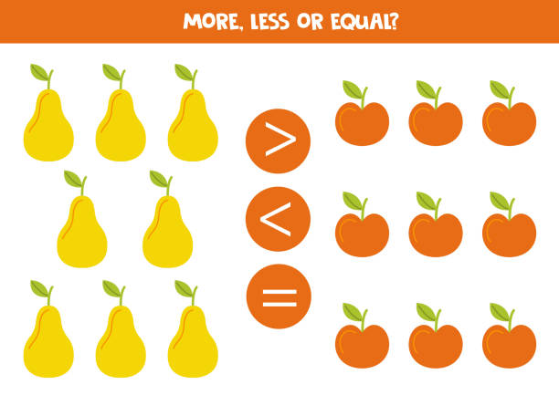
Unsupervised learning
Here the machines learns on its own
by seeing the similarities between data
Here only features are in prominence
By seeing the pattern the
machine under goes
Clustering
association

Slide 8
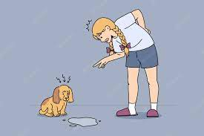
Reinforcement learning
It is the ability of an agent to interact with the environment and find out what
is the best outcome.
It follows the concept of hit and trial method or also called reward and penalty method.

Slide 9
What is cloud computing?
Paying for usage of remote computer
resources is called cloud computing.
What is google colab:
Google colab is a platform where anybody to write and execute arbitrary python code through the browser, and is especially
well suited to machine learning, data analysis and education.

Slide 10
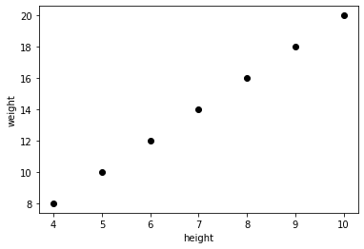
Example for linear regression:
import matplotlib
import matplotlib.pyplot as plt
import numpy as np
import pandas as pd
import sklearn
from sklearn import linear_model
height=[[4.0],[5.0],[6.0],[7.0],
[8.0],[9.0],[10.0]]
weight=[ 8, 10 , 12, 14, 16, 18, 20]
plt.scatter(height,weight,color='black')
plt.xlabel("height")
plt.ylabel("weight")
reg=linear_model.LinearRegression()
reg.fit(height,weight)
X_height=[[12.0]]
print(reg.predict(X_height))
Out put:
[24.]

Slide 11
Example for k nearest neighbors algorithm:
import numpy as np
import matplotlib.pyplot as plt
import pandas as pd
from sklearn.tree import DecisionTreeClassifier
X = [[30],[40],[50],[60],[20],[10],[70]]
y = [0,1,1,1,0,0,1]
from sklearn.neighbors import KNeighborsClassifier
classifier= KNeighborsClassifier(n_neighbors=5, metric='minkowski', p=2 )classifier.fit(X,y)
X_marks=[[50]]
print(classifier.predict(X_marks))
Out put:
[1]

Slide 12
Example for Random forest algorithm:
import numpy as np
import matplotlib.pyplot as plt
import pandas as pd
from sklearn.ensemble import RandomForestRegressor
X = [[30],[40],[50],[60],[20],[10],[70]]
y = [0,1,1,1,0,0,1]
RandomForestRegModel = RandomForestRegressor()
RandomForestRegModel.fit(X,y)
X_marks=[[70]]
print(RandomForestRegModel.predict(X_marks))
Out put:
[1.]

Slide 13
Example for SVM algorithm:
import numpy as np
import matplotlib.pyplot as plt
import pandas as pd
from sklearn.svm import SVC
X = [[30],[40],[50],[60],[20],[10],[70]]
y = [0,1,1,1,0,0,1]
classifier = SVC(kernel = 'linear', random_state = 0)
classifier.fit(X,y)
X_marks=[[55]]
print(classifier.predict(X_marks))
Out put:
[1]

Slide 14
Example for logistic regression algorithm:
import pandas as pd
from sklearn.model_selection import train_test_split
from sklearn.linear_model import LogisticRegression
from sklearn import metrics
import seaborn as sn
import matplotlib.pyplot as plt
candidates = {'gmat': [780,750,690,710,680,730,690,720,740,690,610,690,710,680,770,610,580,650,540,590,620,600,550,550,570,670,660,580,650,660,640,620,660,660,680,650,670,580,590,690],
'gpa': [4,3.9,3.3,3.7,3.9,3.7,2.3,3.3,3.3,1.7,2.7,3.7,3.7,3.3,3.3,3,2.7,3.7,2.7,2.3,3.3,2,2.3,2.7,3,3.3,3.7,2.3,3.7,3.3,3,2.7,4,3.3,3.3,2.3,2.7,3.3,1.7,3.7],
'work_experience': [3,4,3,5,4,6,1,4,5,1,3,5,6,4,3,1,4,6,2,3,2,1,4,1,2,6,4,2,6,5,1,2,4,6,5,1,2,1,4,5],
'admitted': [1,1,0,1,0,1,0,1,1,0,0,1,1,0,1,0,0,1,0,0,1,0,0,0,0,1,1,0,1,1,0,0,1,1,1,0,0,0,0,1]
}
df = pd.DataFrame(candidates,columns= [‘gmat', ’gpa','work_experience','admitted'])
#print (df)
X = df[['gmat', 'gpa','work_experience']]
y = df['admitted']
X_train,X_test,y_train,y_test = train_test_split(X,y,test_size=0.25,random_state=0)
logistic_regression= LogisticRegression()
logistic_regression.fit(X_train,y_train)
y_pred=logistic_regression.predict(X_test)
confusion_matrix = pd.crosstab(y_test, y_pred, rownames=['Actual'], colnames=['Predicted'])
sn.heatmap(confusion_matrix, annot=True)
print('Accuracy: ',metrics.accuracy_score(y_test, y_pred))
plt.show()

Slide 15
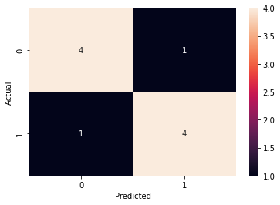
Out put:
Accuracy: 0.8

Slide 16
Example for decision tree algorithm:
import numpy as np
import matplotlib.pyplot as plt
import pandas as pd
from sklearn.tree import DecisionTreeClassifier
X = [[30],[40],[50],[60],[20],[10],[70]]
y = [0,1,1,1,0,0,1]
classifier = DecisionTreeClassifier(criterion = 'entropy', random_state = 0)
classifier.fit(X,y)
X_marks=[[20]]
print(classifier.predict(X_marks))
Out put:
[0]

Slide 17
Features
Features are the inputs given in machine learning.
labels
Labels are the output of the machine learning algorithm.
Model
Model are the programs produced by the machine learning agorithms.

